Slide 1
Roger Stone’s threatening post to Amy Berman Jackson on Instagram
Naga Vamsi Krishna Pabbisetty
March-20-2019

Slide 2
Roger Stone
Political consultant, author, lobbyist and strategist
worked on the campaigns of Republican politicians including Richard Nixon, Ronald Reagan, Jack Kemp, Bob Dole, and Donald Trump.
Accused of being one among the people who meddled with 2016 US Elections
Accused of being in contact with the Russian hacker/Russian disinformation campaign and being in contact with Julian Assange, founder of WikiLeaks during the elections
Sometimes called as a “Trickster”

Slide 3
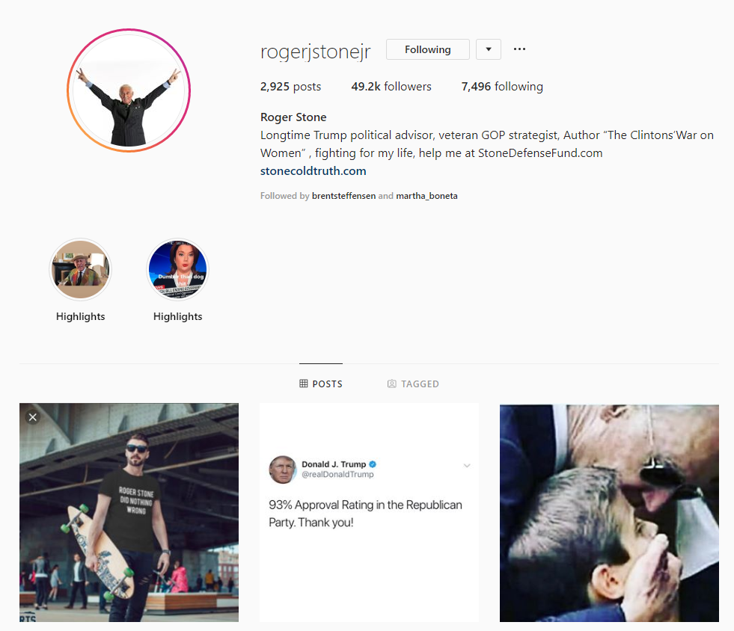
Roger Stone – Instagram
https://www.instagram.com/rogerjstonejr/

Slide 4
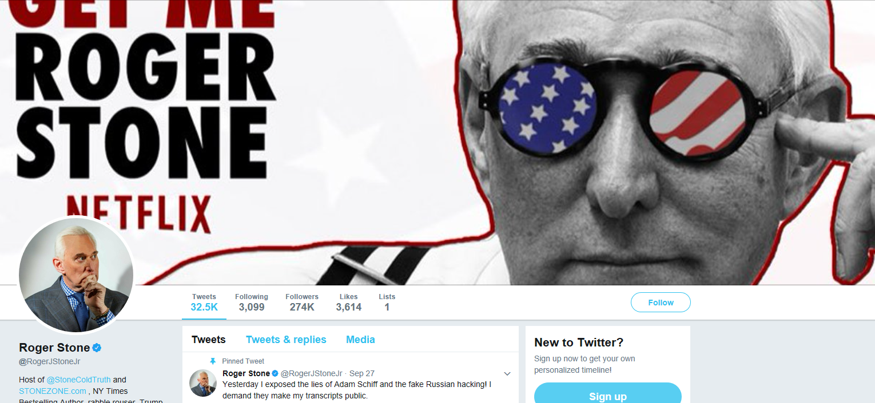
Twitter Account - Suspended
https://web.archive.org/web/20170928135903/https:/twitter.com/rogerjstonejr

Slide 5
Amy Berman Jackson
Appointed as a Federal Judge by Barack Obama in 2010
In January 2019, she was assigned the case of Roger Stone who is indicted of seven counts including false statements, obstruction, and witness tampering
Imposed a limited gag order on Roger Stone on Feb 15, this year
No Twitter, Facebook or Instagram accounts

Slide 6
Timeline of events
Feb 15
Judge Jackson Imposes a limited gag order on Roger Stone,
where he can discuss his case in public anywhere except in DC
Feb 18
Morning
Roger Stone uploads picture of the Judge
with a crosshair(considered as a threat) and calls “Robert Mueller” as a hitman in Instagram
Feb 18
Later he removes the post and adds another picture of Judge Jackson without the crosshair
(without referring to “Robert Mueller” as hitman) and later deletes this post as well
Feb 18
His Lawyers sends an apology to the Judge Jackson on his behalf
Feb 18
His Lawyers sends an apology to Judge Jackson on his behalf
Feb 21
Judge Jackson tightens the gag order,
where he cannot speak about the case in public/social media

Slide 7
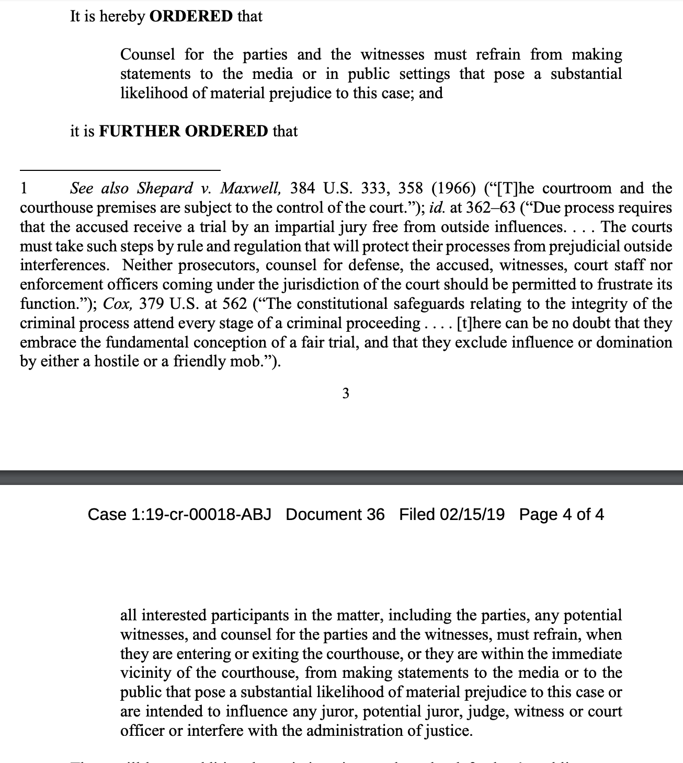
Partial gag order by Judge Jackson
https://assets.documentcloud.org/documents/5751600/Stone-2-15-Partial-Gag-Order.pdf

Slide 8
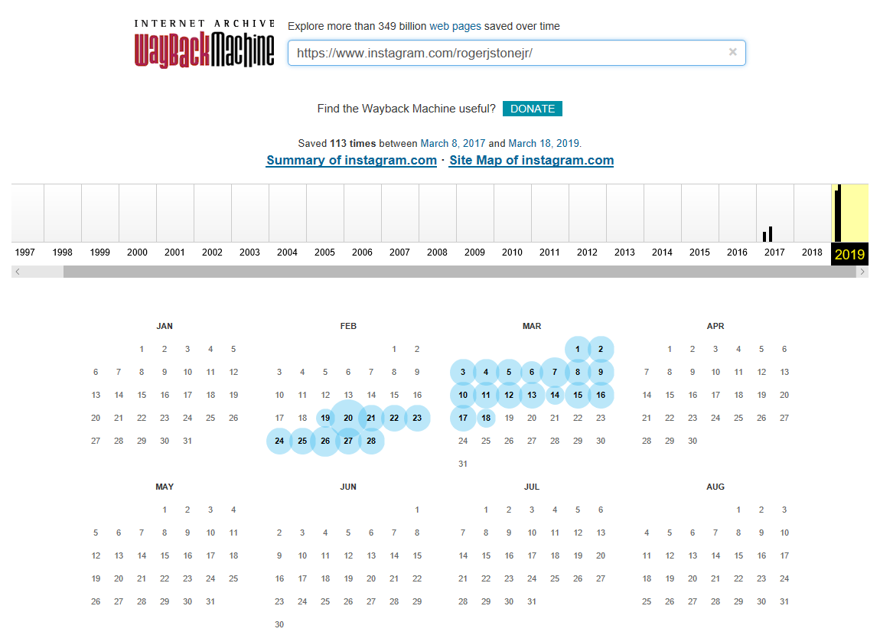
Available Instagram mementos of Roger Stone
https://web.archive.org/web/20190801000000*/https://www.instagram.com/rogerjstonejr/

Slide 9
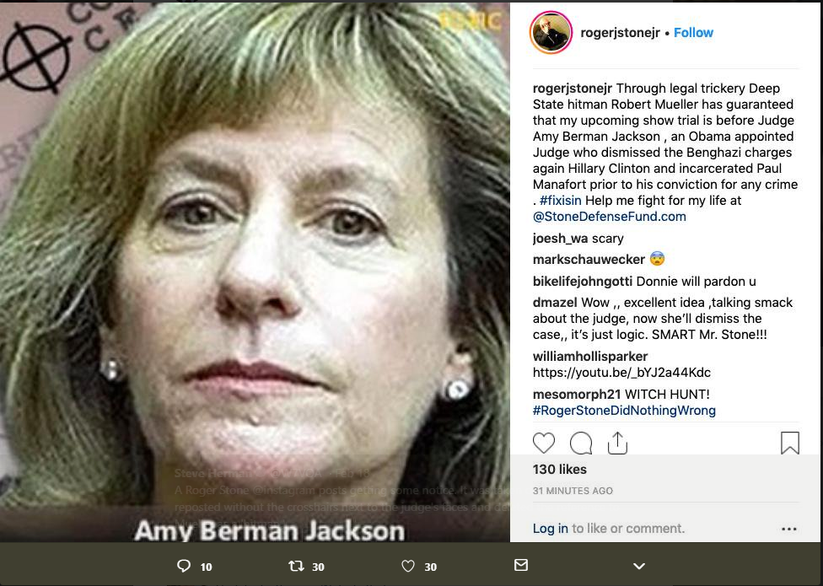


Roger Stone’s Threatening post on Instagram
https://twitter.com/W7VOA/status/1097603079048962051

Slide 10
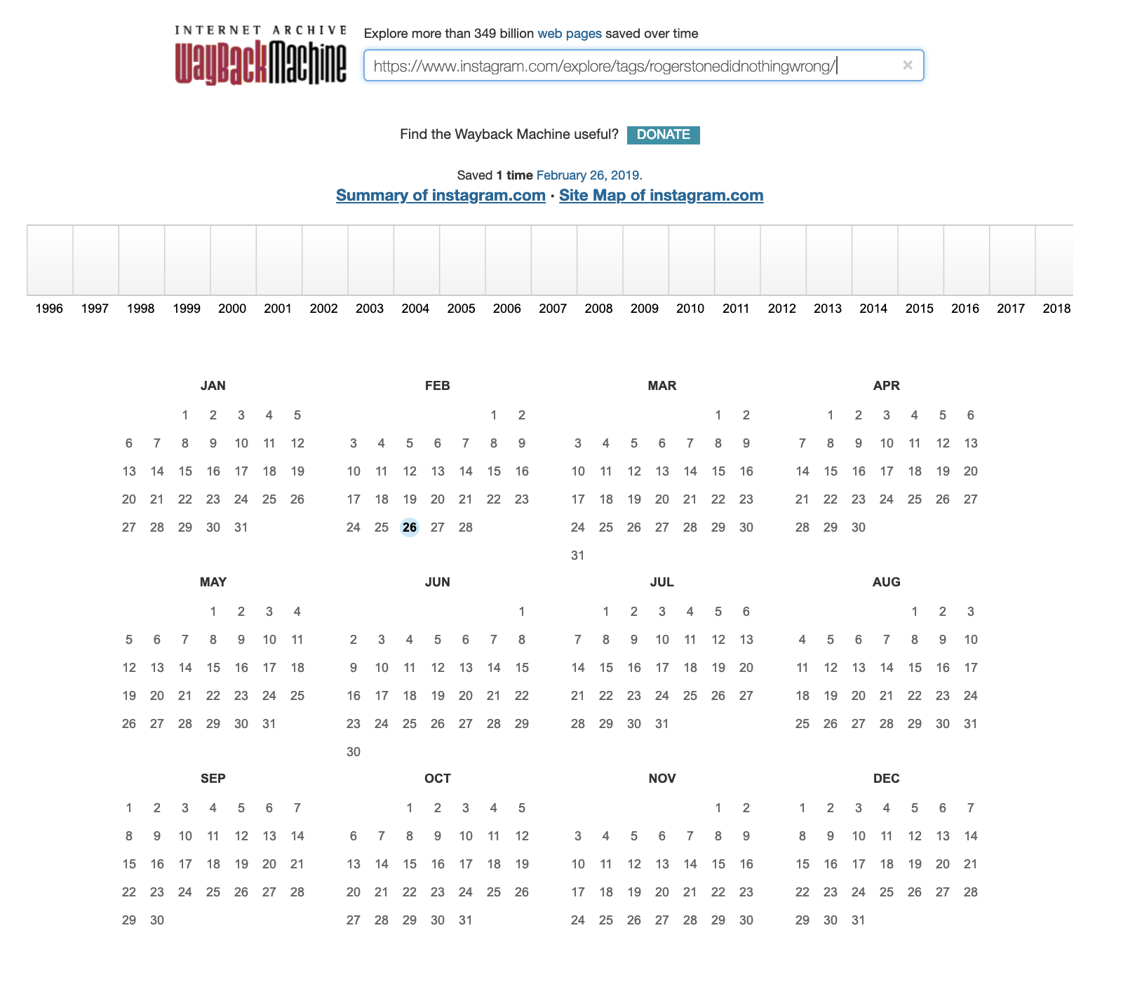
Mementos for #rogerstonedidnothingwrong
https://www.instagram.com/explore/tags/rogerstonedidnothingwrong/

Slide 11
Memgator - # rogerstonedidnothingwrong
MemGator-master 2 nagavamsikrishnapabbisetty$ curl -i https://memgator.cs.odu.edu/timemap/link/https://www.instagram.com/explore/tags/rogerstonedidnothingwrong/
HTTP/1.1 200 OK
Access-Control-Allow-Origin: *
Access-Control-Expose-Headers: Link, Location, X-Memento-Count, X-Generator
Content-Length: 1000
Content-Type: application/link-format
Date: Wed, 20 Mar 2019 19:23:27 GMT
X-Generator: MemGator:1.0-rc7
X-Memento-Count: 1
<https://www.instagram.com/explore/tags/rogerstonedidnothingwrong/>; rel="original",
<https://memgator.cs.odu.edu/timemap/link/https://www.instagram.com/explore/tags/rogerstonedidnothingwrong/>; rel="self"; type="application/link-format",
<http://web.archive.org/web/20190226035246/https://www.instagram.com/explore/tags/rogerstonedidnothingwrong/>; rel="first last memento"; datetime="Tue, 26 Feb 2019 03:52:46 GMT",
<https://memgator.cs.odu.edu/timemap/link/https://www.instagram.com/explore/tags/rogerstonedidnothingwrong/>; rel="timemap"; type="application/link-format",
<https://memgator.cs.odu.edu/timemap/json/https://www.instagram.com/explore/tags/rogerstonedidnothingwrong/>; rel="timemap"; type="application/json",
<https://memgator.cs.odu.edu/timemap/cdxj/https://www.instagram.com/explore/tags/rogerstonedidnothingwrong/>; rel="timemap"; type="application/cdxj+ors",
<https://memgator.cs.odu.edu/timegate/https://www.instagram.com/explore/tags/rogerstonedidnothingwrong/>; rel="timegate"

Slide 12
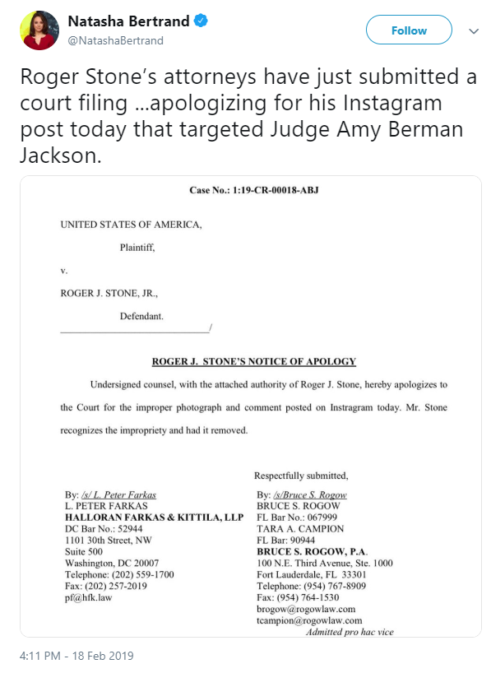
Roger Stone’s apology to Judge Jackson
https://www.documentcloud.org/documents/5743634-Notice-Other.html

Slide 13
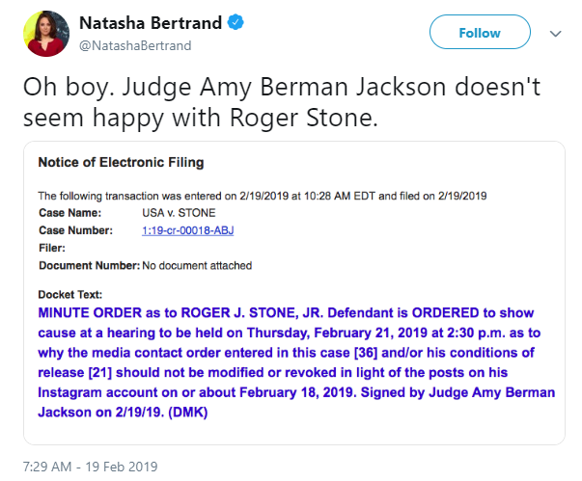
Judge Jackson registers a complaint against Roger Stone
https://www.politico.com/f/?id=00000168-f316-dfa6-a9e8-f7b619d70001

Slide 14
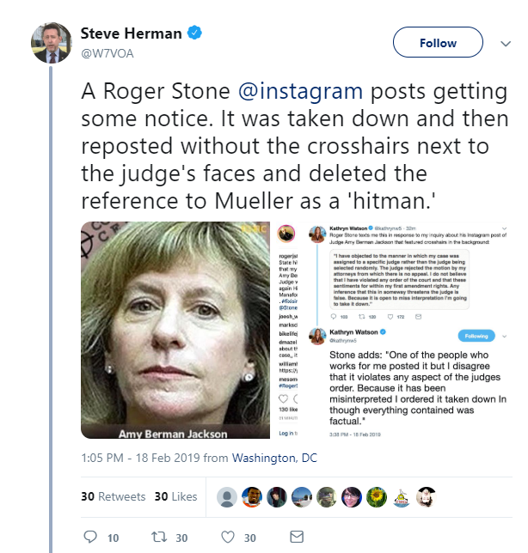
Steve Herman’s reference to both the posts
https://twitter.com/W7VOA/status/1097649667343638533

Slide 15
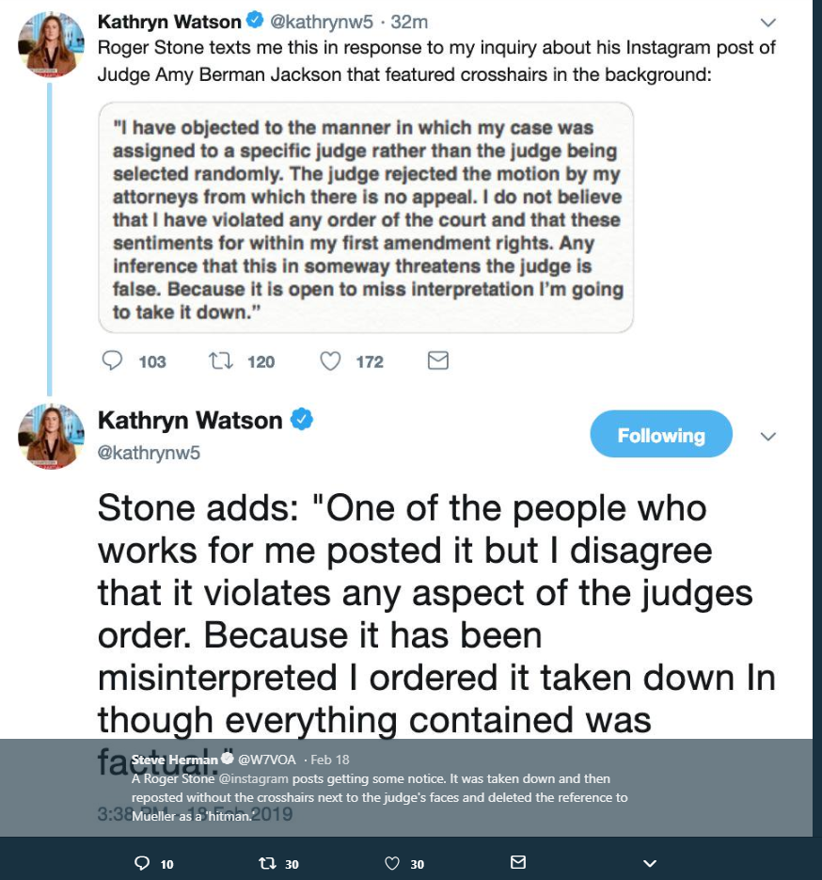
Roger Stone’s response to the Journalist
https://twitter.com/W7VOA/status/1097649667343638533

Slide 16
Judge tightens the gag order on Roger Stone
Feb-21-2019 – Judge Jackson tightens the gag order
Roger Stone cannot speak about his case in public anymore
https://en.wikipedia.org/wiki/Amy_Berman_Jackson

